Slide 1


Arab Academy for Science, Technology and Maritime Transport
College of Language and Communication
Languages Department
Academic Writing- UNR 1407
Essay Writing (Continued)

Slide 2
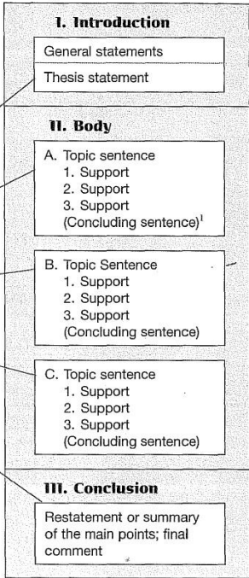
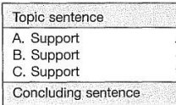
Essay Layout

Slide 3
Body paragraphs
1
Supporting evidence
2
Focus on a single idea
3
Develop and support your thesis
Body paragraphs provide evidence and analysis to convince your reader of your argument.
Each body paragraph should focus on a single idea, using topic sentences, supporting evidence, and explanations to connect your points back to your thesis.
Body paragraphs are the heart of your essay. They develop and support your thesis statement.
4
Each paragraph should be linked to the one before it with transitional devices such as:
•repeating key words/synonyms
• transitional words/phrases.

Slide 4
Concluding Paragraph
It is the final paragraph in an essay. It has three purposes:
It signals the end of the essay. To do so, begin with a transition signal (ex. in conclusion, to conclude, to summarize, etc...).
It reminds your reader of your main points, you can do this either by:
• Summarizing your subtopics/ major ideas (body paragraphs’ topic sentences). OR
• Paraphrasing your thesis statement.

Slide 5
Concluding Paragraph
3. It leaves your reader with your final thoughts/opinion on the topic.
•This is your opportunity to convey a strong, effective message that your reader
will remember.

Slide 6
Concluding Paragraph
Techniques that you can use to write a memorable conclusion:
1. Making a prediction
2. Suggesting results or consequences
3. Suggesting a solution, making a recommendation, or a call for
action
4. Quoting an authority on the topic
Note: You can use more than one method within the same concluding paragraph.

Slide 7
1. Making a prediction
A conclusion that ends with a prediction wrapping up the main points of the writing and then looks forward to what might happen in the future based on the information discussed.
Example
In conclusion, it is obvious that technology has changed how we communicate, learn, and have fun in big ways. From the internet to smart devices, these changes have brought us closer and created new opportunities. As we look to the future, it seems likely that technology will keep advancing quickly, possibly bringing even more surprising changes. The future of technology promises to be both exciting and full of surprises.

Slide 8
2. Suggesting results or consequences
A conclusion that sums up the main ideas and then explains what will likely happen because of them. It shows the effects or outcomes of the topic discussed.
Example
In summary, the advancements we've seen in renewable energy technologies have significantly reduced our reliance on fossil fuels and lowered greenhouse gas emissions. These changes are helping to combat climate change and protect our environment. As we continue to invest in and develop these technologies, we can expect even greater improvements in energy efficiency and sustainability. If these trends continue, we may see a future where clean energy is the norm, leading to healthier ecosystems and a more stable climate for generations to come.

Slide 9
3. Suggesting a solution, making a recommendation, or a call for action
It is a conclusion that wraps up what has been previously said and then suggests what should be done next. It provides a clear solution to a problem, offers advice on what actions to take, or encourages readers to act in a certain way.
Example
In conclusion, while climate change presents significant challenges, there are clear steps we can take to address it effectively. By increasing our investment in renewable energy, improving energy efficiency, and supporting policies aimed at reducing carbon emissions, we can make a substantial impact. It is crucial for individuals, businesses, and governments to work together to implement these solutions. Taking these actions now will help protect our planet for future generations and ensure a more sustainable and healthier world.

Slide 10
4. Quoting an authority on the topic
A conclusion that ends with quoting an authority finishes by including a quote from an expert on the topic. This helps to strengthen the argument and add credibility by showing that a knowledgeable person agrees with the points made.
Example
In conclusion, while the benefits of regular exercise are clear, it is important to remember the advice of fitness expert Dr. Jane Smith, who says, "Exercise is not just about adding years to your life but adding life to your years." Embracing a consistent workout routine not only improves physical health but also enhances overall well-being. By following this expert advice, we can make meaningful changes that contribute to a healthier, more fulfilling life.

Slide 11
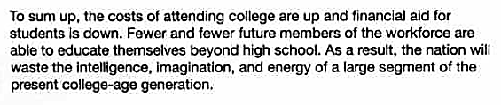
Practice
State the technique used in the following concluding paragraphs.
Suggesting results of consequences

Slide 12
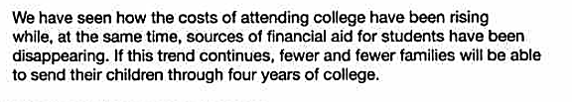
Practice
State the technique used in the following concluding paragraphs.
Making a prediction

Slide 13
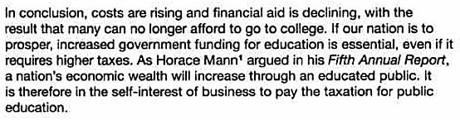
Practice
State the technique used in the following concluding paragraphs.
Quoting an authority

Slide 14
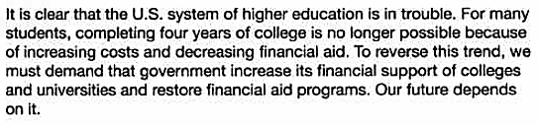
Practice
State the technique used in the following concluding paragraphs.
Recommend a solution

